Slide 1
COMP4057
Lab 1

Slide 2
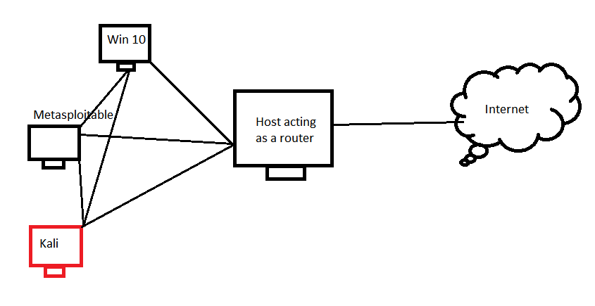
Lab environment setup and installation
Virtualization platform (e.g. Oracle Virtual Box, VMware)
Attacking machine (e.g. Kali Linux)
Target machine 1 (e.g. Metaspoilable)
Tarket machine 2 (e.g. Windows 10)
The links for the respective entities are in the footnote section
Notes:
Oracle Virtual Box: https://www.virtualbox.org/wiki/Downloads
Kali Linux: https://www.offensive-security.com/kali-linux-vm-vmware-virtualbox-image-download/#1572305786534-030ce714-cc3b
Metasplotable download link:
https://information.rapid7.com/download-metasploitable-2017.html
https://information.rapid7.com/download-metasploitable-2017-thanks.html
Windows 10: https://developer.microsoft.com/en-us/microsoft-edge/tools/vms/

Slide 3
Setup cont’d
Install Oracle Virtual Box with default settings
Download Kali Linux and move it to your appropriate location, unzop it (using 7Zip or other tools)
Double click the OVA file and it will automatically populated in VirtualBox
Fix RAM, processor, display, network issue - use NAT Network (why?)
Login to Kali with kali/kali credentials
Change password ASAP

Slide 4
Setup cont’d
Download the Metasploitable VM, unzip it
Create a new machine as Linux (32/64 bit), name it and “Use an existing hard disk” option and point it to the metasploitable VMDK hard disk in the Metaspoitable folder.
Change network setting to NAT Network
Login with msfadmin/msfadmin
Turn off the machine for now: sudo poweroff

Slide 5
Setup cont’d
Download the Windows 10 VM, unzip it
Double click the OVA file and it will populate in Virtual Box
Change RAM from default 4GB to 2GB, you may want to adjust the display as well.
Change network setting to NAT Network
Login with IEUser/Passw0rd!
Get the IP address of your Kali box and ping (why can’t I do other way?)

