Slide 1
Tools walkthrough
Saikat Asaduzzaman

Slide 2
Exiftool - Installation in Linux
Type this to install in Kali Linux: sudo apt install exif
If you get an error of dpkg, then type this to resolve it: sudo dpkg --configure -a
Then type this again: sudo apt install exif
Install Perl library dependency with this: sudo apt install libimage-exiftool-perl

Slide 3
Exiftool - Usage
Get metadata with this command: exif “filename”
List all tags with this command: exif -l “filename”
Extract thumb nail with this: exif -e “filename”
Create exif data if its not there: exif -c “filename”
Ref: https://exiftool.org/

Slide 4
FOCA Installation in Windows
Install FOCA from the Eleven Path website: https://www.elevenpaths.com/innovation-labs/tools/foca
Click download button and it till take you to the GitHub page
Scroll down to the middle of the page under Releases section and click “here”
You also need to download SQL Server Express edition to run FOCA, get it from here: https://www.microsoft.com/en-us/sql-server/sql-server-downloads

Slide 5
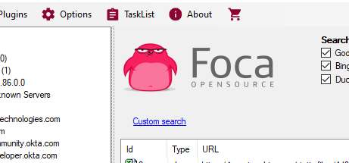
FOCA Usage
Launch the tool, create project
Adjust the plugins from the Options tab
Also check the module filter to FOCA only

Slide 6
FOCA usage
Download all files from the target site
Then analyze the metadata
Go under metadata summary and check out the metadata

Slide 7
NMAP scripting engine (NSE) in Linux
NMAP has a bunch of scripts that you can run using its scripting engines
The script can range from simple search as finding a banner to complex brute forcing with custom word list.
Try this command in terminal:
$nmap --script banner <website name>

Slide 8
NMAP scripting engine (NSE) in Linux
Using http-grep: To grep a key word from the target server
e.g: nmap -p 80 www.okta.com --script http-grep --script-args 'http-grep.builtins ={"mastercard", "discover"}, http-grep.url="okta.html"'

Slide 9
NMAP scripting engine (NSE) in Linux
Using http-enum: Enumerates directories used by popular web applications and servers.
e.g: nmap --script http-enum scanme.nmap.org

Slide 10
NMAP scripting engine (NSE) in Linux
Using dns-brute: Attempts to enumerate DNS hostnames by brute force guessing of common subdomains
e.g: nmap --script dns-brute scanme.nmap.org

Slide 11
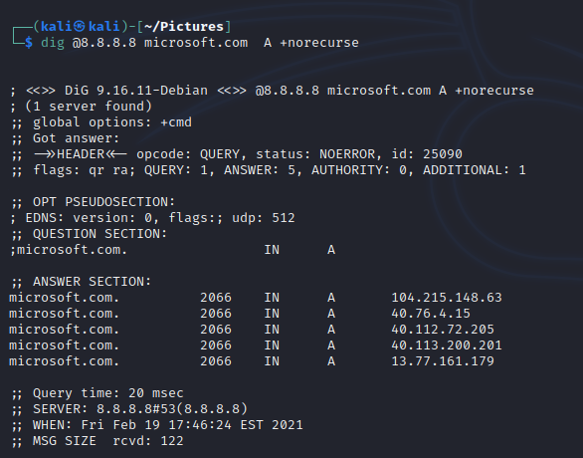
Dig - in Linux
Modern Kali might not have Dig installed by default, install it with sudo apt install dnsutils
verify by dig -v
Use DNS Cache Snooping with this: dig @8.8.8.8 microsoft.com A +norecurse

Slide 12
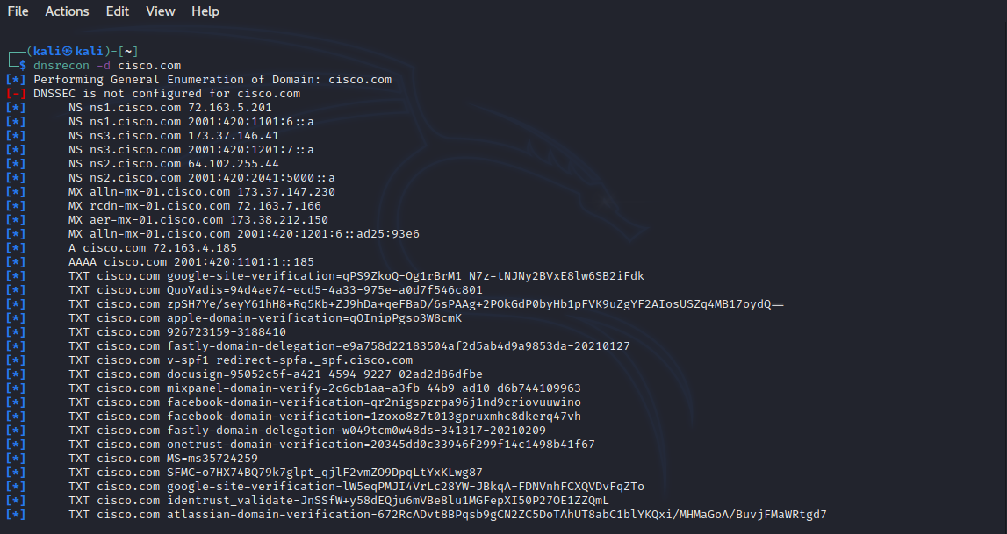
DNS Recon - in Linux
dnsrecon -d scanme.nmap.org -D /usr/share/dnsrecon/namelist.txt
dnsrecon -d <website name>

Slide 13
DNS Recon - in Linux
Dnsrecon reverse lookup - trying to find out IP addresses from domain names
Use this: dnsrecon -d <target website> -w

